Slide 1
Paediatric Postoperative Pain Audit
Great North Children’s Hospital
Notes:
Hello, I am Charlotte Gray, a medical student at Newcastle University. I completed this audit in May during my Student Selected Component in Paediatric Anaesthetics at the RVI at the end of my 4th year.
The audit was already in progress but I was asked to continue the work of a previous medical student so that conclusions could be drawn.

Slide 2
Contents
Background
Objectives
Methods
Results
Conclusions

Slide 3
Contents
Background
Objectives
Methods
Results
Conclusions

Slide 4
Background
Current postoperative take-home medication:
paracetamol and ibuprofen only
European Medicines Agency Pharmacovigilance Risk Assessment Committee review in 2013 ^{[1]}
Several reports of fatal respiratory depression
Advisory to restrict take-home opioids
Adenotonsillectomy for obstructive sleep apneoa particularly susceptible

Slide 5
Response from the GNCH
Stopped use of codeine
Oramorph as postoperative analgesia in the hospital only

Slide 6
Contents
Background
Objectives
Methods
Results
Conclusions

Slide 7
Objectives
Which surgeries require stronger painkillers
Who may benefit from an oral morphine prescription to take home
Notes:
Quality Improvement Plan

Slide 8
Contents
Background
Objectives
Methods
Results
Conclusions

Slide 9
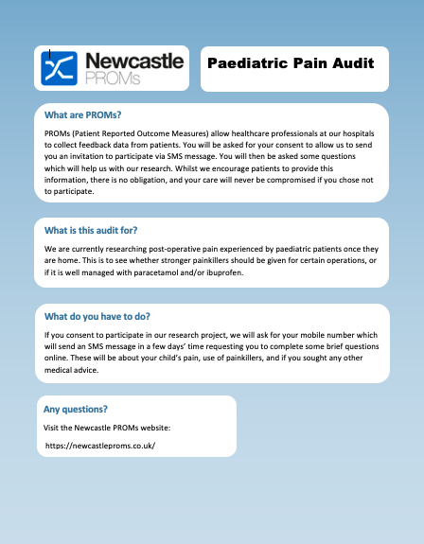
Methods
Newcastle PROMs (Patient Reported Outcome Measures) ^{[2]}
SMS-delivered survey for patients
Patient-reported quantitative data
Data collection:
Leaflet
Consent
MRN and mobile number
Notes:
All patients were gained from Ward 8, the Surgical Unit, of the Great North Children’s Hospital.

Slide 10
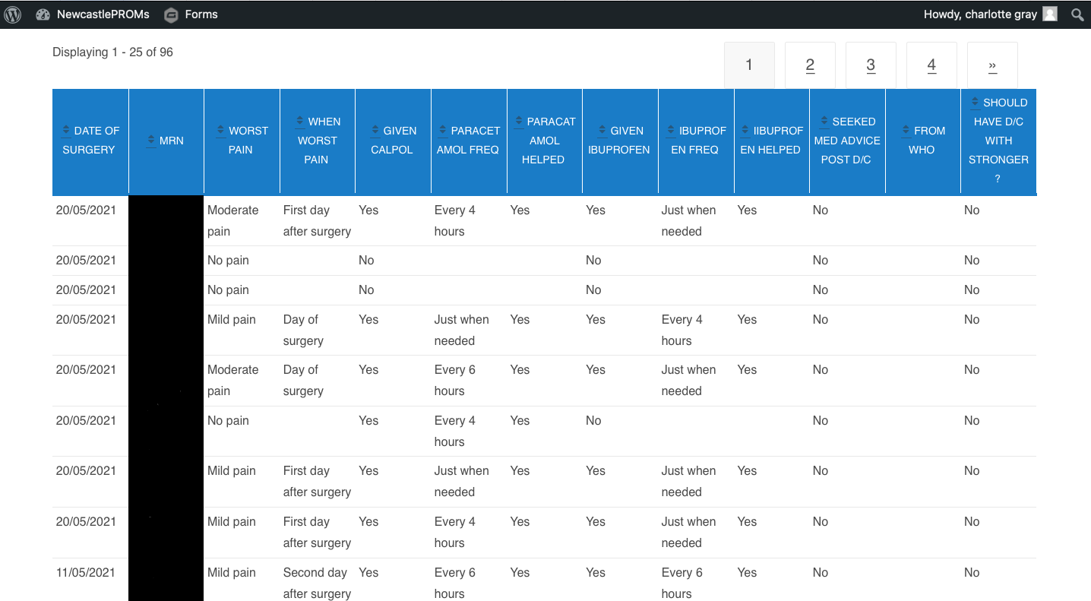
Notes:
Overall, 96 patients completed the survey and their data appeared in the spreadsheet on Newcastle PROMs

Slide 11
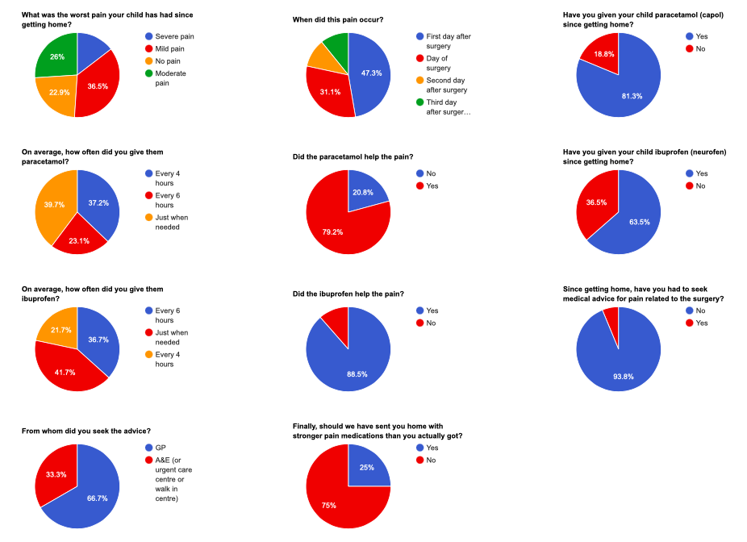
Notes:
Once the data was collated on the spreadsheet, it could be made into pie charts for a visual representation of the data, which can be viewed by anyone who can log onto the audit on Newcastle PROMs.

Slide 12
Contents
Background
Objectives
Methods
Results
Conclusions

Slide 13
Results
Notes:
Out of the 96 patients, almost a quarter felt that they needed stronger pain medication.

Slide 14
Results
Notes:
ENT – 27 surgeries – a third
Orthopaedics – 10 surgeries - 50%
Plastics – 10 surgeries – 30%

Slide 15
Notes:
In fact, focusing on orthopaedic for a moment, 50% of those undergoing orthopaedic surgery felt that the current take-home medication was not sufficient

Slide 16
Notes:
Far and above, adenotonsillectomy and tonsillectomy… 9/14
There’s a lot of orthopaedic operations scattered among the results as well, including removal of orthopaedic metal, bone biopsies and amputation

Slide 17
Contents
Background
Objectives
Methods
Results
Conclusions

Slide 18
Conclusions
Almost a quarter of patients felt the medication was inadequate
Tonsillectomies and adenotonsillectomies are most in need of stronger pain medication
Orthopaedic surgery pain control needs to be looked into
Notes:
Some form of opiate needed

Slide 19
Limitations
“Codeine should not be used at all in children (aged below 18 years) who undergo surgery for the removal of the tonsils or adenoids to treat obstructive sleep apnoea, as these patients are more susceptible to respiratory problems.”
- EMA’s PRAC review 2013 ^{[1]}
Notes:
However, the review by the EMA’s PRAC in 2013 highlighted the detrimental effect that codeine use had on tonsillectomy and adenotonsillectomy patients. Therefore, the GNCH is reacting to this by only advising the use of take-home morphine. Minimise complications by using small doses and a limited number of doses.

Slide 20
The next stage
Pain nurse
4 areas to proceed with:
Information distribution
Prescribing
Dispensing
Surgeon’s approval
Notes:
Pushing for funding for a pain nurse who will have a large role in the roll out of the new morphine prescriptions, as well as management of post-operative pain at home
A leaflet has been designed and audited, which will be given to the parents on ward 8 before discharge so they are aware how and when to use the morphine.
A discussion needs to be had within the anaesthetics team as to how and when morphine is prescribed in theatre.
The pharmacy has been contacted as to the best way to dispense the take-home morphine.
Surgeon’s need to be on board wit hthe plan.
A rolling audit, similar to this one, will then be carried out to assess the impact once home.

Slide 21
Acknowledgments
I would like to acknowledge Dr Adnaan Qureshi for providing the platform of Newcastle PROMs, which was used for the data analytics
Also, Dr Clare Watkinson, Dr Jo McClintock and Dr Maria Clement, who provided me with help and support throughout the audit and for this presentation
Notes:
Thank you so much for listening, I would now be happy to take any questions.

Slide 22
References
European Medicines Agency. (2014). Codeine: restricted use as analgesic in children and adolescents after European safety review. Retrieved from GOV.UK: file:///private/var/folders/71/h1nfnmq97yq0pvpxc8z3_g940000gn/T/com.microsoft.Outlook/Outlook%20Temp/Codeine_%20restricted%20use%20as%20analgesic%20in%20children%20and%20adolescents%20after%20European%20safety%20review%20-%20GOV.UK.html
Qureshi, A. (2021). Newcastle PROMs Home. Retrieved from Newcastle PROMs: https://newcastleproms.co.uk

